Slide 1
Chapter 6
Aggregating Data
Using Group Functions

Slide 2
Objectives
After completing this lesson, you should be able to do the following:
Identify the group functions available in Oracle
Use the GROUP BY clause
Use the HAVING clause

Slide 3
What are group functions?
Group functions operate on one or more rows to give one result per group
Also known as aggregate functions
AVG, COUNT, MAX, MIN, SUM
STDDEV, VARIANCE

Slide 4
SYNTAX:
SELECT [column, ]
group_function([DISTINCT | ALL] expression) FROM table [WHERE condition] [GROUP BY column] [HAVING group condition] [ORDER BY column];

Slide 5
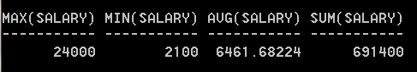
Using group functions
SELECT MAX(salary), MIN(salary), AVG(salary), SUM(salary)
FROM employees;

Slide 6
Using MAX and MIN functions
You can use MIN and MAX for any datatype (Character and date)
SELECT MIN(hire_date), MAX(hire_date)
FROM employees;
MIN(hire_date) MAX(hire_date)
------------------------ ------------------------
17-JUN-87 21-APR-00

Slide 7
Using the COUNT function
COUNT has 2 formats:
COUNT(*) returns the number of rows that satisfy the condition in the WHERE clause. (Null values have no effect)
COUNT(column_name) returns the number of non-null entries in that column

Slide 8
How many employees are in Dept. 30?
SELECT COUNT(*)
FROM employees
WHERE department_id = 30;
COUNT(*)
----------------
6

Slide 9
2 things to remember about group functions:
They always operate on a group of rows at a time
Rows with NULL values are ignored
unless NVL, NVL2 or COALESCE are used.
Except for COUNT(*) which counts all rows (even rows containing all NULL values)

Slide 10
SELECT COUNT(*), COUNT(salary) FROM employees;
There are 10 employee records, each containing a salary value of 100, except for one record which has a NULL for salary. What will be displayed?
10 10
10 NULL
10 9
9 9

Slide 11
SELECT COUNT(*), COUNT(salary) FROM employees;
There are 10 employee records, each containing a salary value of 100, except for one record which has a NULL for salary. What will be displayed?
10 10
10 NULL
10 9
9 9
COUNT(*) counts all rows –no exceptions
COUNT(salary) only counts non-nulls in the salary column.

Slide 12
Using NVL with group functions
SELECT AVG(commission_pct)
FROM employees;
AVG(COMMISSION_PCT)
-----------------------------------
.222857143
average is calculated
ONLY on the rows
where there is a non-null
value in the commission_pct
column.

Slide 13
Using NVL with Group functions
SELECT AVG(NVL(commission_pct, 0))
FROM employees;
AVG(NVL(COMMISSION_
-----------------------------------
.072897196
average is calculated
on all of the rows
in the table.

Slide 14
Using the GROUP BY clause
Scalar
Group
SELECT [column], group_function(column)
FROM table
[WHERE condition]
[GROUP BY column]
[HAVING group condition]
[ORDER BY column];
All columns in the
SELECT list that are
not in group functions
must be in the
GROUP BY clause.

Slide 15
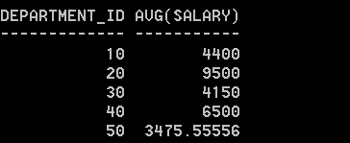
Using the GROUP BY clause
SELECT department_id, AVG(salary)
FROM employees
GROUP BY department_id
ORDER BY 1;

Slide 16
Illegal queries using Group functions
SELECT department_id, COUNT(ename)
FROM employees;
SELECT department_id, COUNT(ename)
*
ERROR at line 1:
ORA-00937: not a single-group group function

Slide 17
Grouping by more than one column
Sometimes need to have group within groups
Ex: sum the salaries in the employees table for each job within each department.
Main grouping: department_id, then job_id

Slide 18
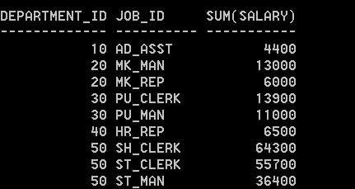
SELECT department_id, job_id, SUM(salary)
FROM employees
GROUP BY department_id, job_id
ORDER BY 1, 2;

Slide 19
HAVING clause is used to select certain groups
Rows are grouped
The group function is applied
Groups matching the HAVING clause are displayed

Slide 20
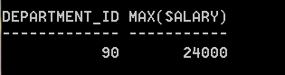
Using the HAVING clause
SELECT department_id, MAX(salary)
FROM employees
GROUP BY department_id
HAVING MAX(salary) >= 20000;

Slide 21
Where do you put GROUP BY and HAVING clauses?
[WHERE condition]
[GROUP BY column]
[HAVING group condition]
[ORDER BY column];
Must appear between
WHERE and ORDER BY
Clauses.
HAVING may occur before GROUP BY, but it is a more common
practice for HAVING to occur after GROUP BY

Slide 22
In-class exercise:
Display each job id and sum of the salaries for the job id (call this column Payroll) for each job except SA_MAN. Only display those jobs where the payroll exceeds $5000. Sort the display by payroll.

Slide 23
Nesting group functions
Group functions can only be nested to a depth of two.
SELECT MIN(AVG(salary))
FROM employees
GROUP BY department_id;
MIN(AVG(salary))
----------------
3475.55556
This is the minimum
Average salary for any
department

Slide 24
Order of evaluation of clauses:
WHERE clause
Restricts individual rows
GROUP BY clause
Server makes groups from rows selected
HAVING clause
Restricts which groups appear in the result

Slide 25
One last thing…
You can’t have an aggregate function in the WHERE clause
SELECT job, COUNT(employee_id)
FROM employees
WHERE COUNT(employee_id) > 1
* Error – group function not allowed in WHERE clause

